Slide 1
Parallel Architectures
CS121 Parallel Computing
Fall 2021

Slide 2
Parallelism hierarchy
Parallelism exists at many different levels of a computer system.
Within a single core.
A multicore processor.
A medium scale shared memory parallel computer.
A large scale distributed memory system.

Slide 3
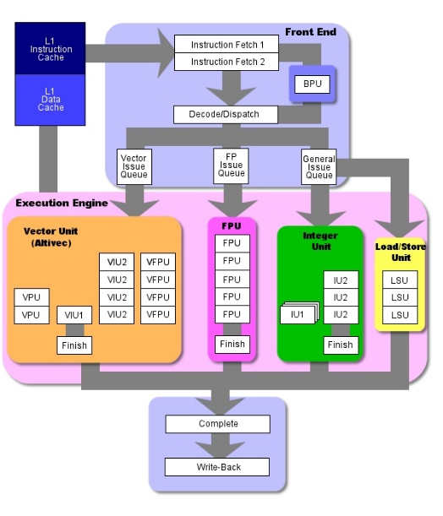
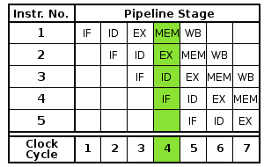
Implicit parallelism - Pipelining
Implicit parallelism executes straight line code in parallel on multiple FUs.
CPU contains multiple functional units, e.g. instruction fetch / decode, load / store, integer / floating point units, etc.
Pipelining
Break up one instruction and execute pieces in pipeline.
Ex 5 stage pipeline potentially offers 5X speedup.
Modern processors have 10-20 stages.
If code branches, must guess how to fill pipeline.
Branch misprediction requires flushing pipeline.
Typical code branches every 5 instructions, so requires accurate prediction.

Slide 4
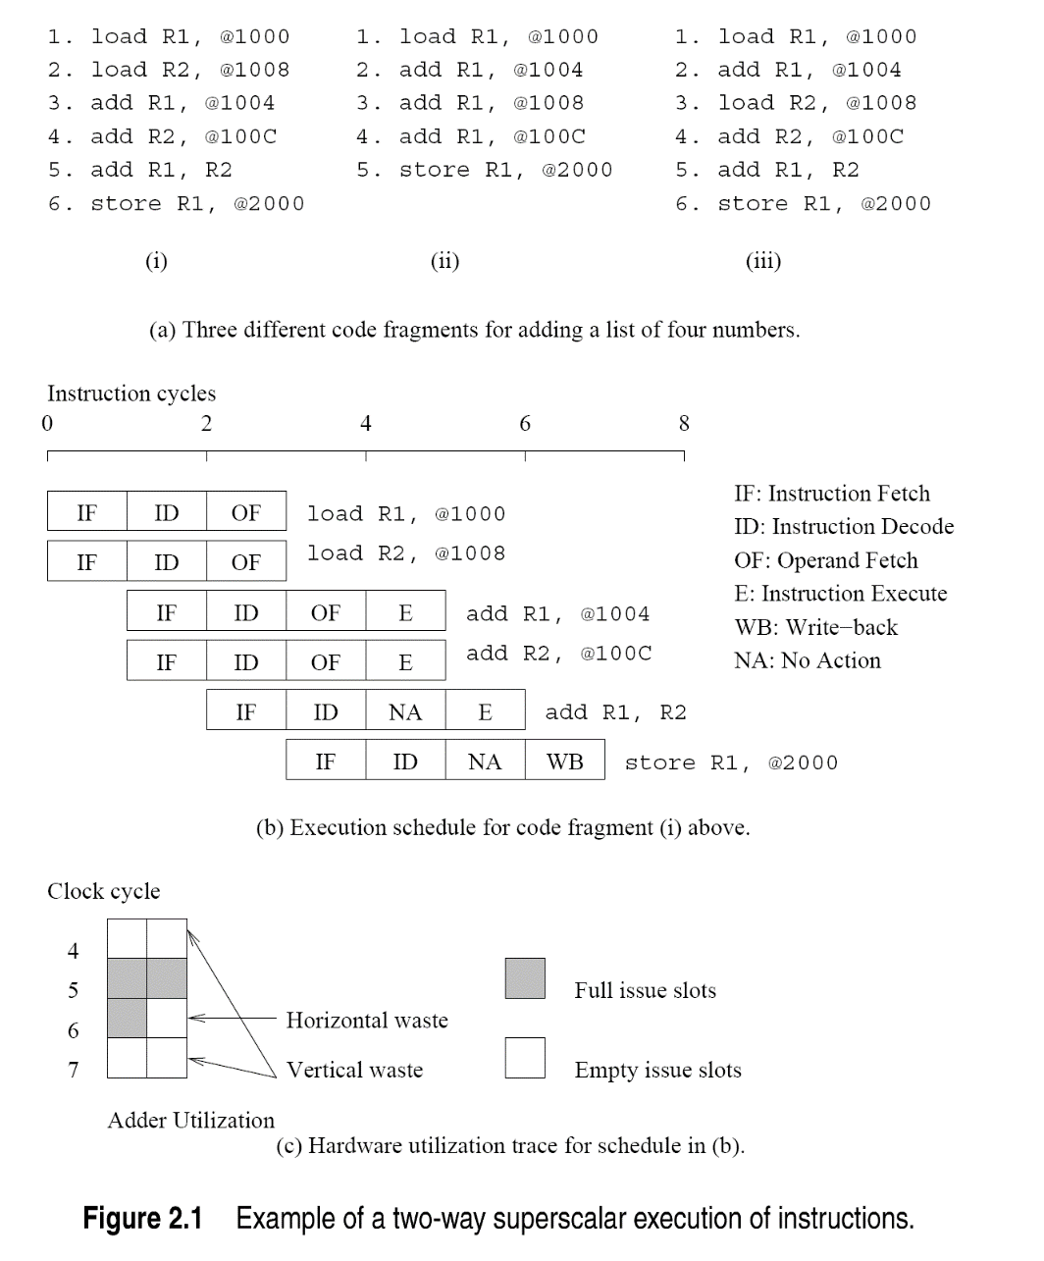
Implicit parallelism - Superscalar
Superscalar processors issue multiple instructions each clock.
Execution must respect data dependencies, where one instruction uses results of another.
All three code fragments add 4 numbers, but first code has fewer data dependencies (so more parallelism) than second.
Third code requires look-ahead and reordering hardware to detect independence of instructions 1 and 3.
Source: Introduction to Parallel Computing, Grama et al., 2003

Slide 5
Implicit parallelism - VLIW
Superscalar
Resource dependency is when multiple instructions use same hardware unit.
Branch dependency occurs when code can take different paths based on a conditional.
Waste occurs when no instruction issued in a clock cycle.
VLIW (very long instruction word) finds and packs parallelizable instructions at compile time.
Superscalar finds parallelism at runtime.
Pro Compiler can do more sophisticated search.
Con Compiler doesn’t have runtime state, e.g. branch history, cache misses, for efficient scheduling.

Slide 6


Memory performance
We need data before we can compute. So processor performance often depends on memory performance.
Key measures are latency and bandwidth.
Latency is amount of time for processor to access piece of data.
Bandwidth is amount of data transferred from memory to processor per unit time.
Ex Consider a highway.
Latency is the how fast you can drive on the highway (or alternatively, the length of the highway).
Bandwidth is how many lanes the highway has.
Latency and bandwidth are independent.
Ex you can have low latency & low bandwidth, high latency & high bandwidth, etc.
Latency is more important if frequently transfer small amounts of data.
Bandwidth matters when transferring large piece of data.

Slide 7
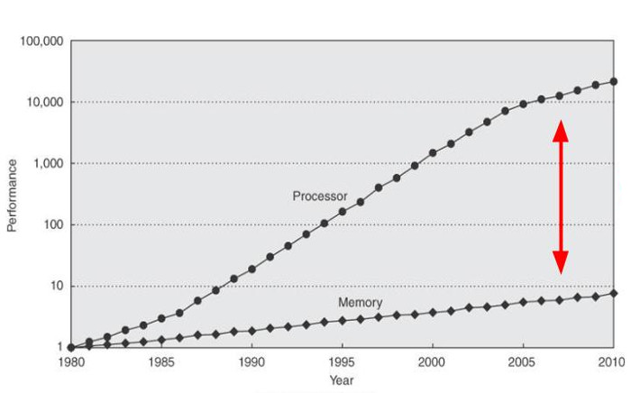
CPU-memory gap
Processors today can compute much faster than memory can transfer data.
Ex 100 GFLOPS, 20 GB/s bandwidth and 100 ns latency to main memory.
Performance is bandwidth limited. Can only transfer 5 billion floats / sec, only 5 GFLOPS!

Slide 8
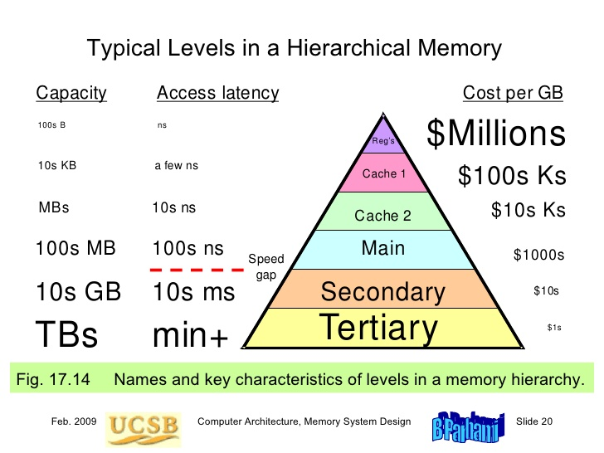
Memory hierarchy

Slide 9
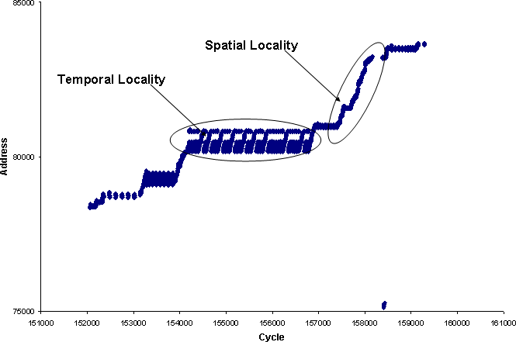
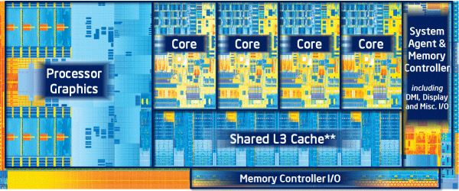
Caching
Cache is small but fast piece of memory built directly on CPU die.
Low latency, high bandwidth.
Used to decrease (effective) latency. Also helps alleviate bandwidth limitations.
When accessing data, processor first checks cache, and only goes to memory if data isn’t in cache.
Caches effective due to temporal and spatial locality in (most) code.
Temporal locality Small set of data accessed repeatedly.
Store in cache and access quickly.
Spatial locality
Nearby pieces of data accessed together.
Ex Iterating through an array.

Slide 10
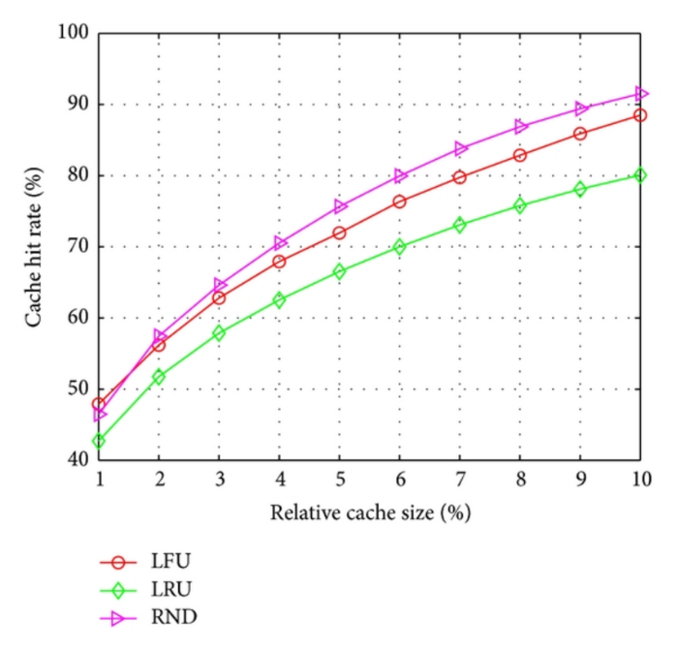
Caching performance
Cache hit rate is the proportion of data accesses serviced from the cache.
Typically a concave function in the cache size.
Processors have several layers of cache, each layer faster but smaller.
Algorithms can sometimes be transformed to have greater locality.
Caches can dramatically improve performance.
Ex 1 GHz processor with 100 ns latency DRAM. Assume one round trip per word, one FLOP per word transferred.
Transfer 10M words / sec ⇒ 10 MFLOPS.
Suppose cache has 5 ns latency and 80% hit rate.
Avg latency per word = 5*0.8 + 100*0.2 = 24 ns.
Transfer 42M words / sec ⇒ 42 MFLOPS.
With 90% hit rate, latency = 5*0.9+100*0.1 = 14.5 ⇒ 69 MFLOPS.

Slide 11
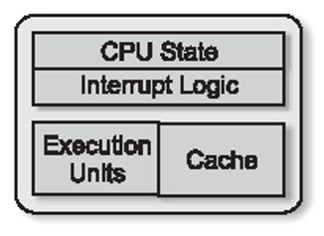
Processor architectures
A core is an independent execution unit that can run one or more threads.
Core contains memory controller, instruction fetch / decoder, execution units, registers storing CPU state, etc.
Cores and caches can be combined in various ways to form processors.
Single core processor

Slide 12
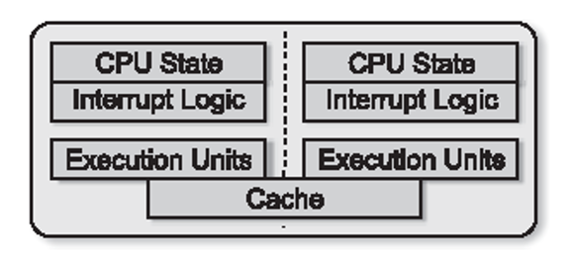
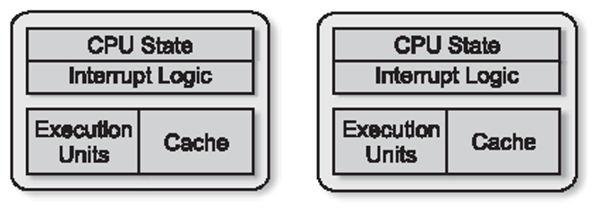
Processor architectures
A multiprocessor contains several cores communicating through memory.
A multicore (aka CMP, or chip multiprocessor) has several cores on a single die.
Each core is a complete processor, with own execution unit and CPU state.
Cores share an L2 / L3 cache.
Increases cache utilization, but might cause thrashing.
Threads on different cores run simultaneously.
Allows fast communication (i.e. cache coherency) between cores.
Cheap to manufacture, simpler board design, very popular.
Multiprocessor
Multicore processor

Slide 13
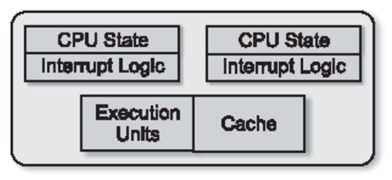
Threads and multithreading
Thread is an independent instruction stream with its own state, i.e. CPU registers, program counter and stack.
A program can contain multiple threads running concurrently.
Threads can communicate through memory and cooperate on a problem.
Simultaneous multithreading (SMT)
Relatively cheap to maintain the state of a thread.
A logical processor can be created using only the thread state.
Can fit several logical processors in one core.
Execution units and cache still shared, only state hardware duplicated.
Cheap way to get (some) extra performance and hide latency.
Intel supports two threads per core (hyperthreading), Sun UltraSparc supports 8 threads, etc.
Hyperthread processor

Slide 14
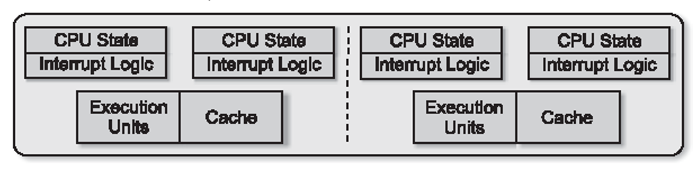
Multithreaded multicore
Individual cores can use multithreading. Combine several cores in one package.
Widely used, e.g. Intel Core, Xeon, AMD Ryzen, Sun UltraSparc, IBM POWER, etc.
Hyperthreading improves performance by 15-30%, depending on application and scheduling.
Threads may compete for resources such as cache or execution units and actually decrease performance.
Processors allow deactivating multithreading.
Multicore hyperthreading processor

Slide 15
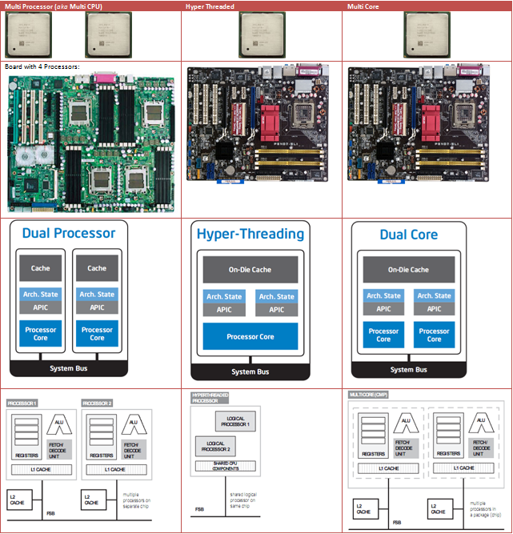
Source: http://superuser.com/questions/214331/what-is-the-difference-between-multicore-and-multiprocessor

Slide 16
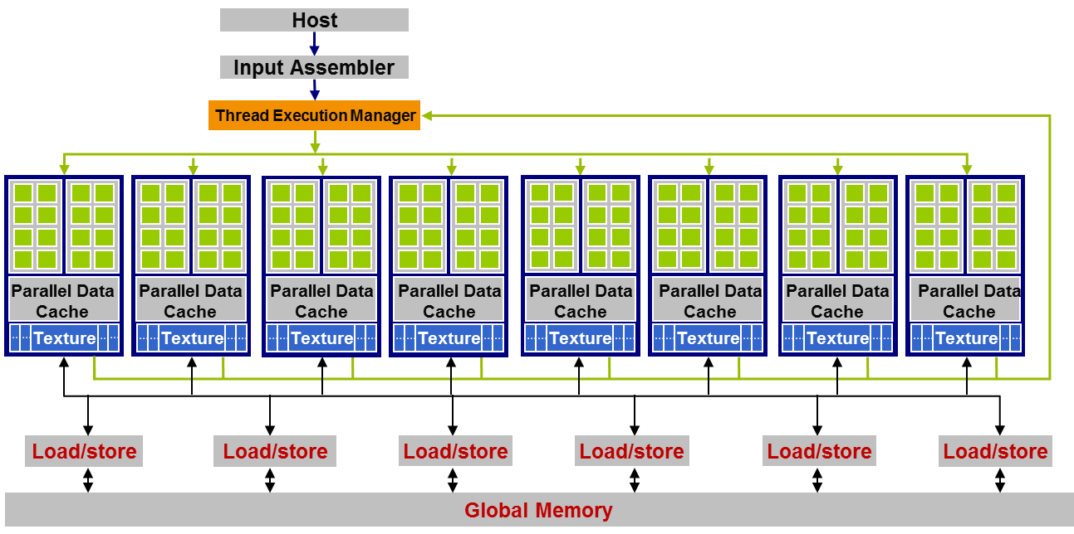
GPGPU
General purpose graphics processing unit (or just GPU).
Using massive parallelism of graphics cards for general purpose computation.
Dozens of “streaming multiprocessors”.
Each SM contains 32 simple cores and runs 32 threads simultaneously.
All cores do the same instruction.
Tens of thousands of active threads.
Hardware quickly switches between them to hide I/O latency.

Slide 17
Flynn’s taxonomy
A parallel system consists of multiple communicating, cooperating processors.
Processors may be single / multicore, single / multithreaded, GPUs / accelerators, etc.
Unlike sequential computing, which follows the von Neumann architecture, there is a wide variety of parallel system architectures.
Flynn (1966) classified parallel systems based on instructions and data used by the processors.
SISD Single instruction, single data
Conventional sequential processor.
SIMD Single instruction, multiple data
Single control unit for multiple processing units.
MISD Multiple instruction, single data
Uncommon; but pipelining is a form of MISD.
MIMD Multiple instruction, multiple data
Use different hardware designs based on software characteristics.

Slide 18
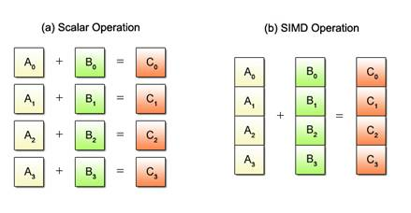
SIMD
Control unit fetches single instruction and broadcasts it to processing units.
PEs each apply instruction to its own data item, in synchrony.
Ex Adding two arrays.
All PEs perform addition, on different coordinates of the arrays.
Very popular today.
Effective for data parallel programs, e.g. graphics and video, dense linear algebra, machine learning.
Cheap to implement, don’t need to duplicate hardware for fetch / decode, branch prediction, OOO, etc.
Used in GPUs (SIMT), Intel AVX, Xeon Phi, IBM Cell SPU.
Early generations supercomputers were SIMD with very wide lanes (1000s bits).
Modern SIMD execute 4-32 lanes.
PE
PE
Global
control
unit
Interconnection network
PE
PE
PE

Slide 19
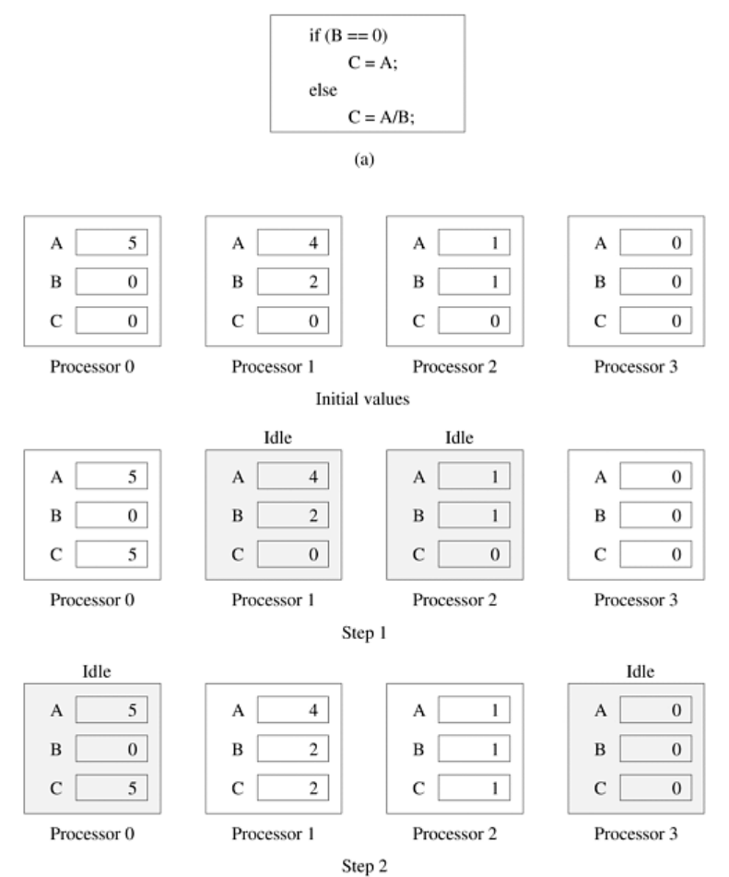
Instruction divergence
SIMD processors can perform different instructions, but need an activity mask to deactivate processors in certain steps.
Takes k steps to do k different instructions. In each step all processors doing same instruction execute synchronously.
SIMD works poorly for heavily branching code, where execution is data dependent.
Also doesn’t work well when threads not balanced, e.g. graph algorithms, sparse linear algebra.

Slide 20
MIMD
General purpose multiprocessor system.
Each processor has its own instruction and data.
Processors communicate through an interconnection network.
A broad category covering most parallel computers.
Most commodity processors are a combination of MIMD with SIMD capability.
Ex Intel Xeon. Different cores are MIMD. But each core implements SIMD AVX.
Ex Most supercomputers contain commodity processors plus SIMD coprocessors.
PE +
control unit
PE +
control unit
Interconnection network
PE +
control unit
PE +
control unit

Slide 21
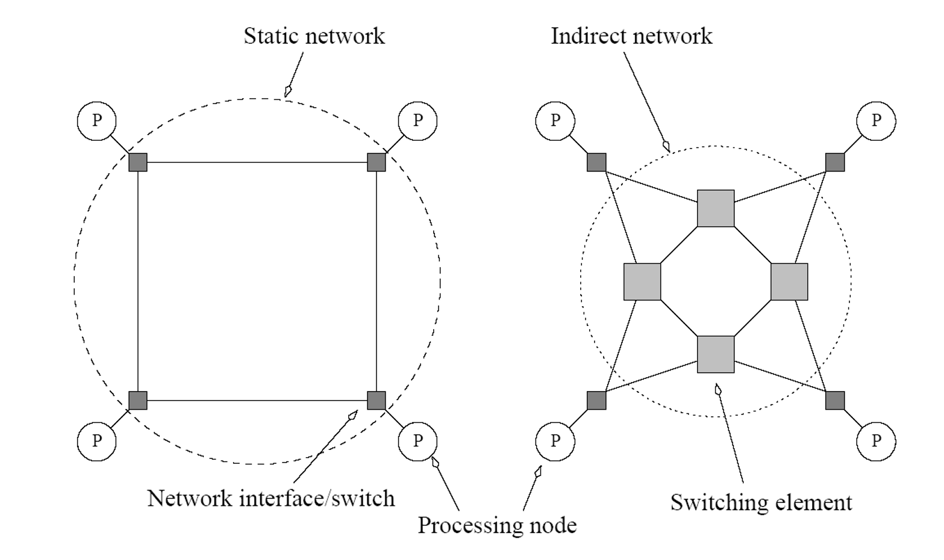
Interconnection networks
Network allows processors to share data and cooperate.
Built using links and switches.
Links are fixed connection between two processors.
Switch connect set of processors on input ports with processors on output ports.
Static or direct networks built from links.
Dynamic or indirect networks built from switches.
Switches route data between processors.
Can also buffer, multicast, etc.
Wire complexity of switches quadratic in degree, i.e. number of processors on input / output ports.

Slide 22
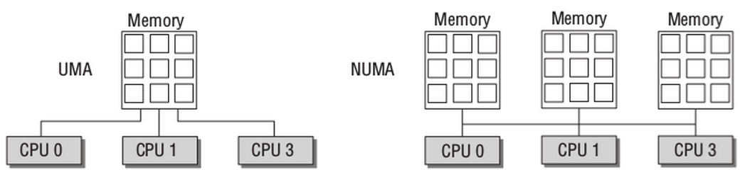
Shared memory architecture
A single memory address space for all processors.
Any address can be accessed by any processor.
Easier to program and reason about.
While memory is logically one block, physically there may be multiple memory banks connected on a network.
OS takes care of locating the data.
Limited scalability (100s of processors) due to bandwidth requirement on interconnect.
Can attach caches to processors to avoid some accesses to main memory.
Needs cache coherence, i.e. changes to data in one processor’s cache needs to be reflected in other processor using same data.
Coherence traffic also limits scalability.
Memory access times can be uniform (UMA) or non-uniform (NUMA).
In UMA access times for all memory banks roughly equal.
In NUMA, accessing physically local memory faster than accessing remote memory.

Slide 23
Distributed memory architecture
Each processor can only directly address its own memory.
To access remote data, processor sends message over interconnect network to data’s owner.
Also called message passing architecture.
Programmer keeps track of where data is located.
Harder to program than shared memory, but scales better.
Large scale parallel computers are all distributed memory, because overhead of providing one logical memory is too high.
Can also combine distributed and shared memory.
Ex Supercomputer is overall a distributed memory system connecting shared memory nodes.
PE + Mem +
control unit
PE + Mem +
control unit
Interconnection network
PE + Mem +
control unit
PE + Mem +
control unit

Slide 24
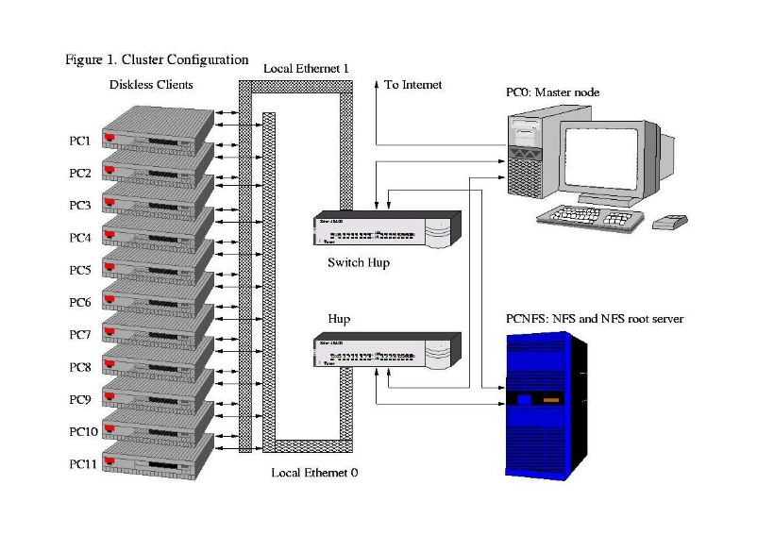
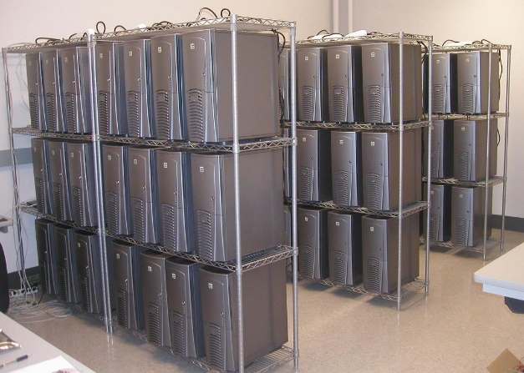
Network of workstations (NOW)
Networked computers as a multicomputer platform
Popularized in 1990’s as high performance workstations and networking became commoditized (cheap).
Advantages
Relatively high performance and low cost.
The latest processors can easily be incorporated into the system as they become available.
Existing software can be used or modified.
Ex Beowulf, SETI@Home, Folding@Home

Slide 25
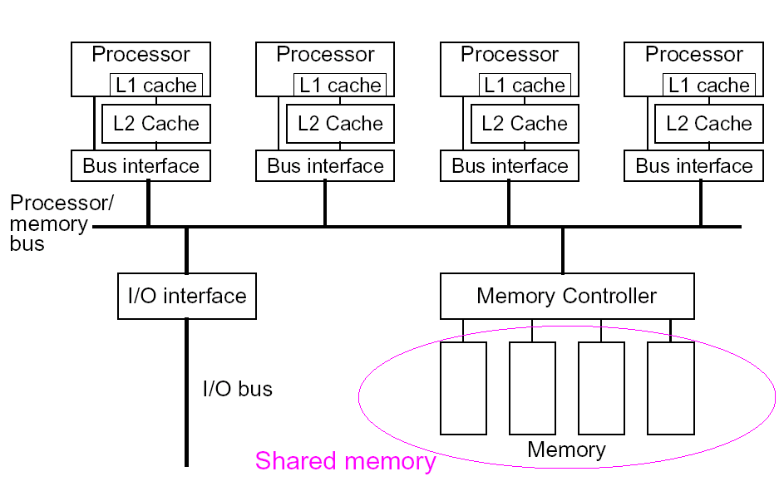
Bus architecture
All processors communicate with memory through common bus.
To communicate, a processor needs exclusive access to the bus.
Processors need media access control protocol to communicate concurrently.
Bus has limited bandwidth, becomes communication bottleneck.
Caches help avoid bus traffic for many memory operations.
But still limited to small scale systems, (~50 processors).
Usually used for shared memory systems.

Slide 26
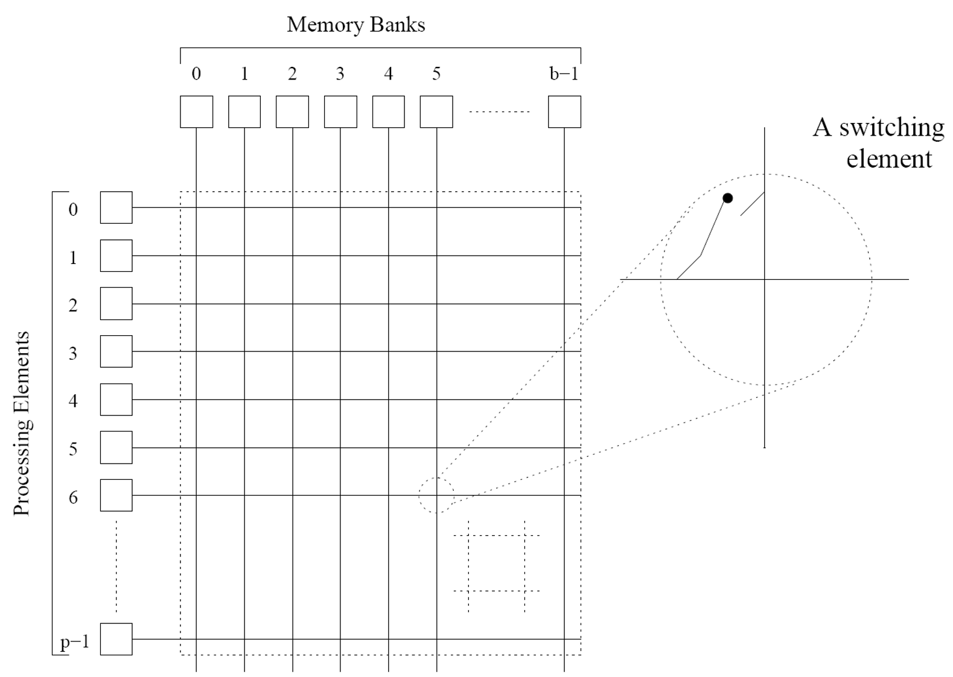
Crossbar architecture
Switched (dynamic) network for higher end shared memory systems.
Allows all processors to communicate with all memory modules simultaneously.
Nonblocking, i.e. one processor’s communication won’t prevent another’s.
Higher bandwidth and more scalable than bus.
But more complex and expensive to implement.
Limited to a few hundred processors.
Source: Introduction to Parallel Computing, Grama et al.

Slide 27
Multihop networks
Bus and crossbar are both one stage networks, i.e. two processors can directly communicate over a link.
One stage networks have limited bandwidth and scalability, and sometimes high cost.
Can improve performance using multistage or multihop networks, where messages traverse several links.
Multihop networks can be characterized by
Diameter
Distance between farthest pair of processors.
Gives worst case latency.
Bisection width
Minimum number of links to cut to partition the network into two (almost) equal halves.
Indicates potential communication bottlenecks.
Bisection bandwidth is sum of bandwidths of links cut.
Cost
Number of links in network.
Bisection width.
2
2
1
1
1
1
1
2
2

Slide 28
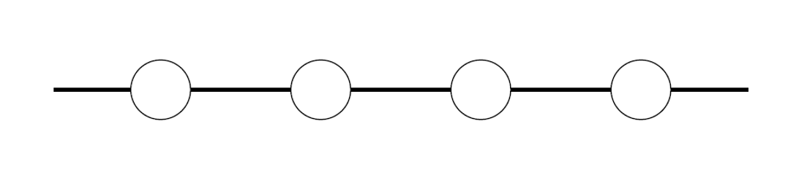
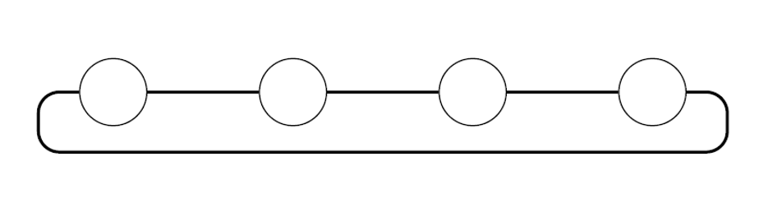
1D topologies
Linear array
Diameter
Bisection
Cost
p - 1
1
p-1
High diameter, low fault tolerance, low cost.
Diameter
Bisection
Cost
p / 2
2
p
Ring
Slightly improved diameter and fault tolerance, low cost.
All nodes symmetric.

Slide 29
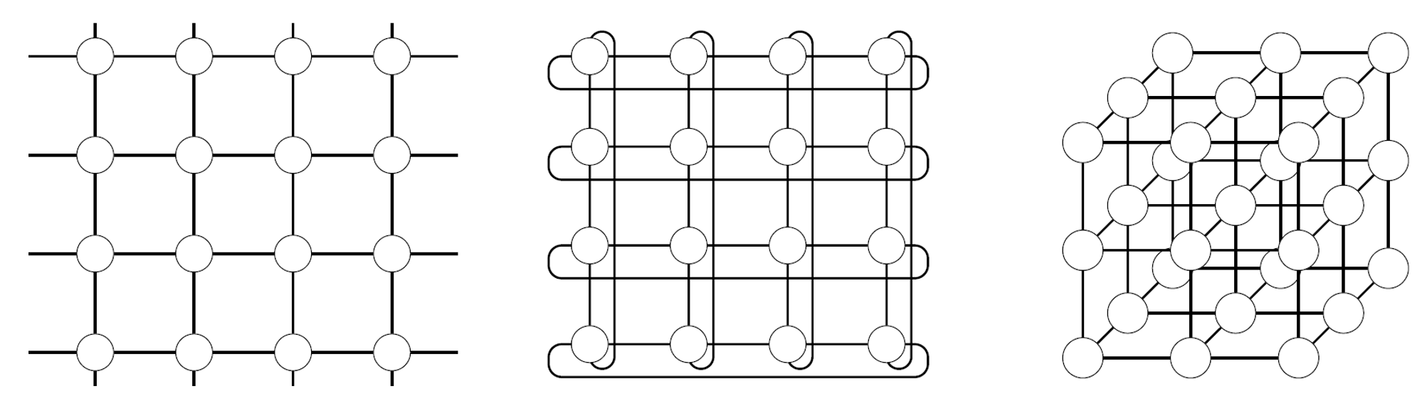
Meshes and tori
2D mesh
2D torus
3D mesh
Diameter
Bisection
Cost
Diameter
Bisection
Cost
Diameter
Bisection
Cost
2√p – 2
√p
2p-2√p
√p – 1
2√p
2p
3 ³√p – 3
(³√p)²
3p-3(³√p)²

Slide 30
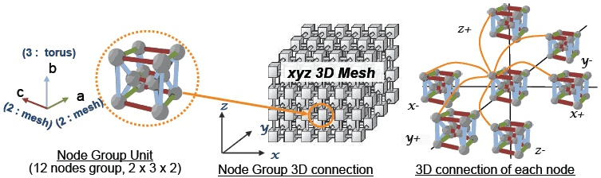
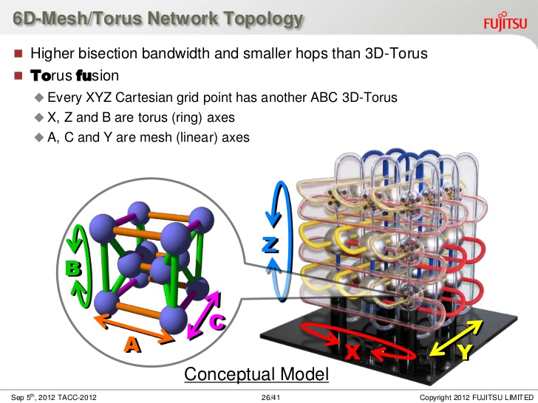
6D “tofu” network on Fujitsu K computer.

Slide 31
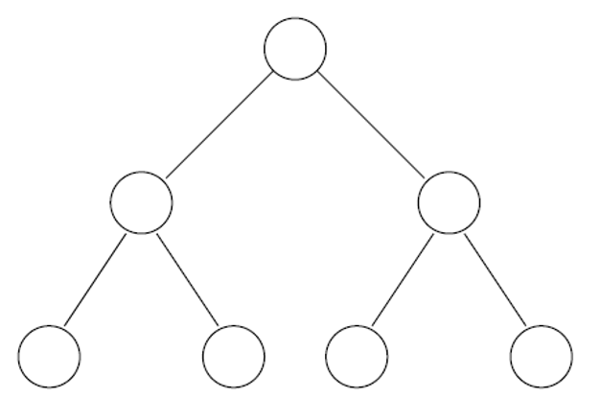
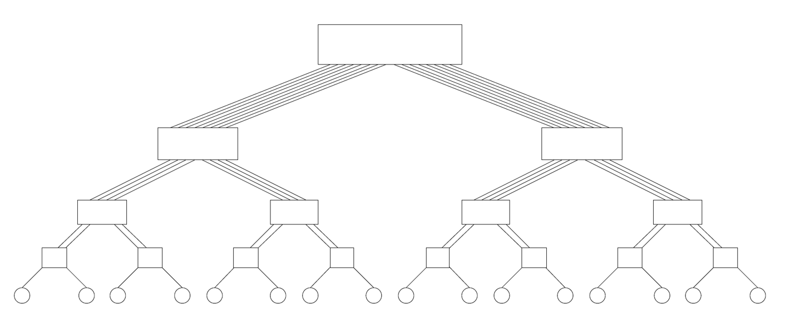
Trees
Tree
Diameter
Bisection
Cost
2 log (p+1)
1
p
Excellent diameter and cost, low fault tolerance.
Root is communication bottleneck and single point of failure.
Fat tree
Diameter
Bisection
Cost
2 (log p)
p / 2
p log p / 2
Each processor has twice as many links to its parent as to each child.
When routing, messages traverse random links.
Used in e.g. Tianhe-2.

Slide 32
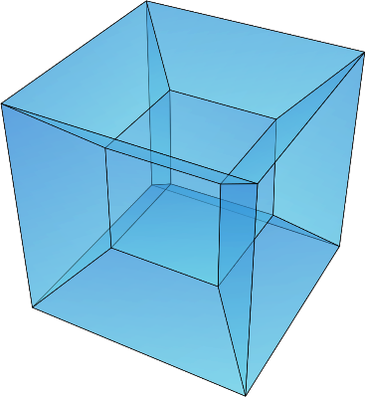

Hypercubes
Diameter
Bisection
Cost
log p
p / 2
p log p / 2
Excellent diameter and fault tolerance.
CM-1 used a 20-dim hypercube!
4D hypercube
5D hypercube
0-D
0
1
0
000
010
1-D
1
001
011
3-D
4-D
00
10
100
110
2-D
01
11
101
111

